Slide 1
Tableau visualizations
Andy Tse

Slide 2
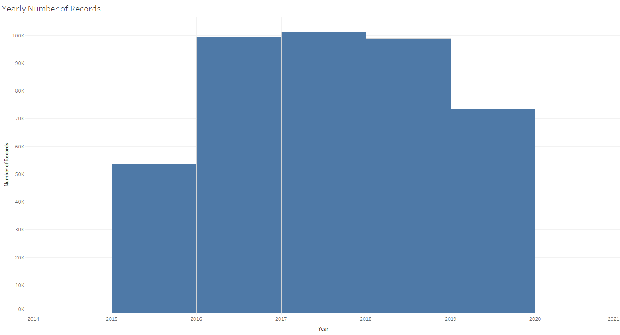
Number of Records distributed by year
In this histogram, the years 2016, 2017, and 2018 have the highest number of crimes recorded.
Although, 2015 has the least amount of entries, and 2019 almost have all of it complete, in which forecasting will be the best predictor.

Slide 3
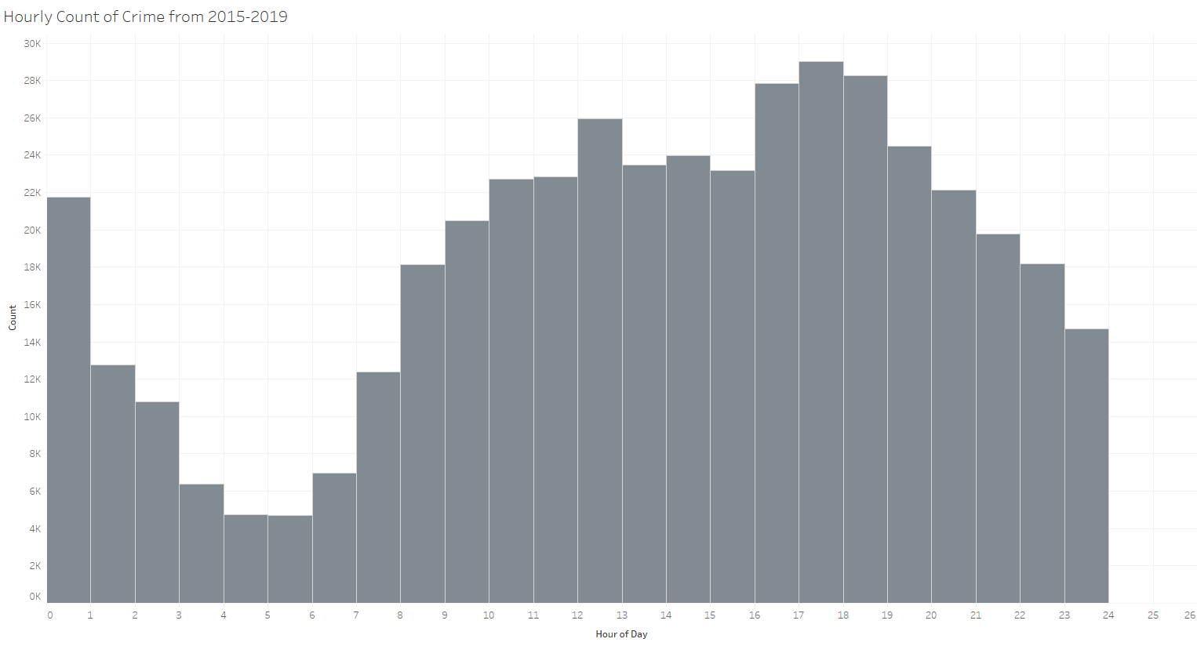
Histogram by hour
From looking at the count by hour overall, the distribution is heading towards more in the later hours from 15 to 20.
One of the hours stands out to have the most is the lunch hour from 12-1.

Slide 4
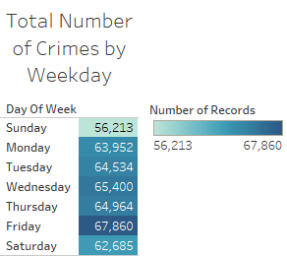
Which day has the most crime?
Looking at the highlight table, it shows that from Wednesdays to Saturdays, total amount of crimes are at the peak.
Sunday is the least amount of crimes for that day.

Slide 5
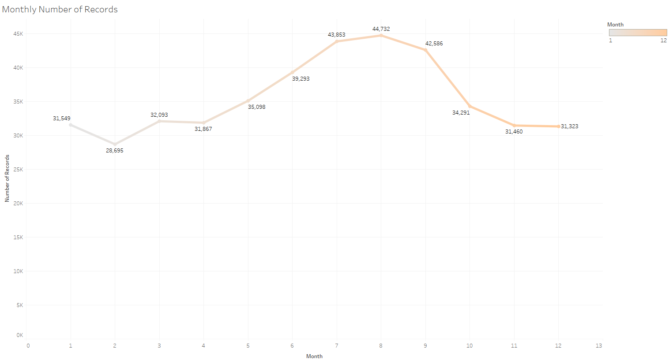
Monthly breakdown from 2015-2019
By looking through the four years of the analysis on a monthly basis, it turns out that months five to nine have an upward trend.
From months ten to twelve and to the next year of months one and two are heading on the downward trend.
Most common factor is the weather, as the middle of the year is much warmer.
The later months and early months in the start of the year is much colder.

Slide 6
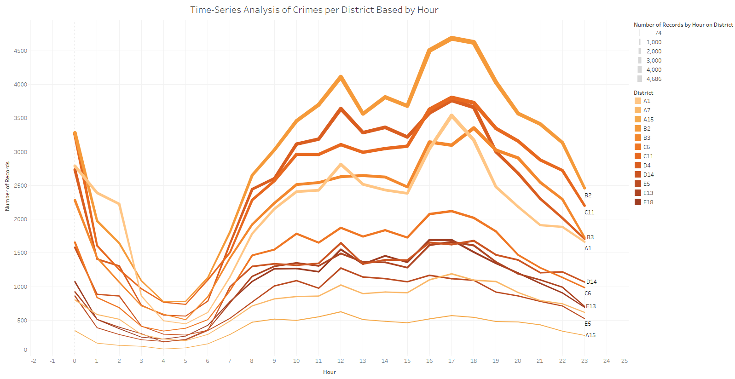
Time series district by hour from 2015-2019
By looking at this graph, the peaks are at the hours from 15-20 at all districts.
Districts B2, C11, and B3 are the ones that have the most crime on a daily basis.
Recommend that more police force to patrol in those areas, and emergency medical services if needed.

Slide 7
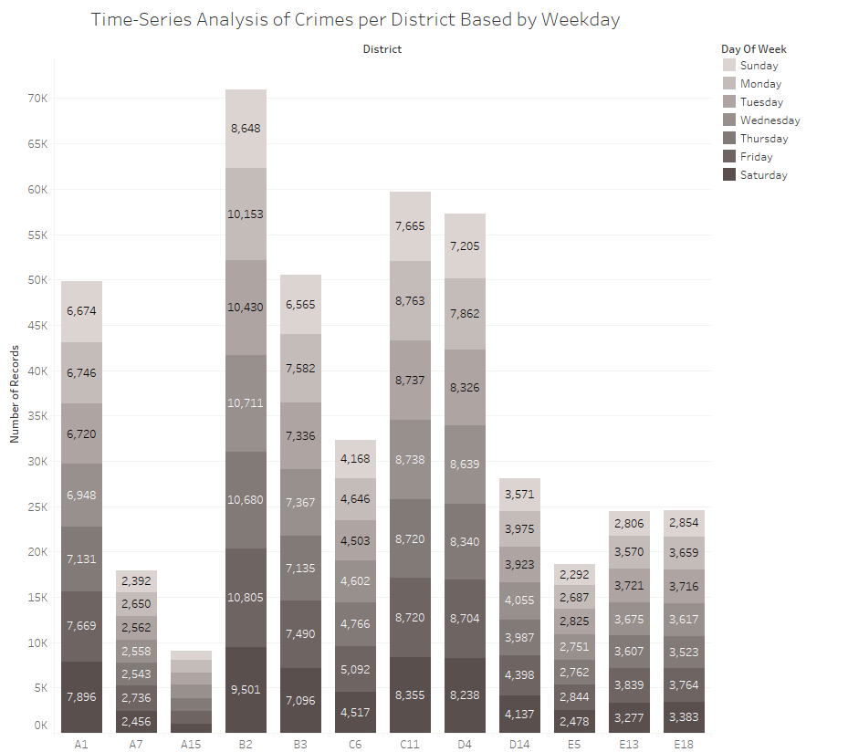
District of crimes per weekday
For this graph, the count of crimes are highlighted by day and district as a stacked bar chart.
From looking at the totals, it shows that Districts B2, C11, and D4 are the highest counts for crime on a daily basis.
Same recommendation from the previous slide.
By looking at all the districts, Friday is the day where the counts have peaked.

Slide 8
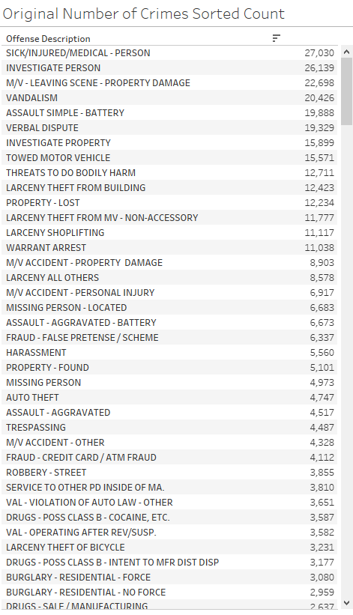
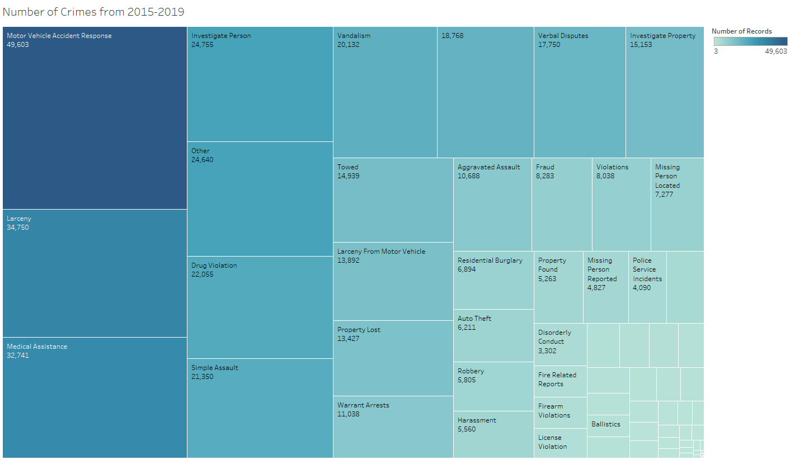
Crimes by type
By looking at the table data on the left and the heatmap on the right as a comparison, it is shown that I have grouped together all the types of crimes in order to separate them into different categories. This is a way to determine which unit in the police department to solve on. Also, assign emergency medical services to areas where there are the most accidents/incidents.

Slide 9
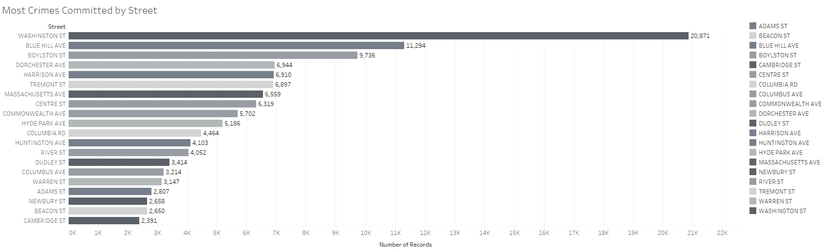
Top 20 streets for crime
In this bar chart, these are the top 20 streets that have the most crime from 2015-2019.
Recommend the Boston Police Department to patrol the top 5 streets throughout the day. Assign emergency medical services in order to get the victims of crime to the hospital.

Slide 10
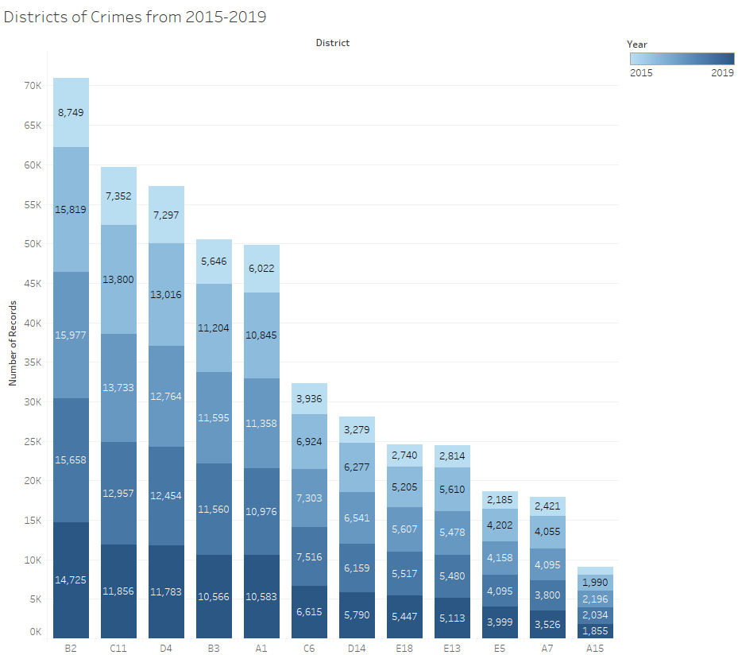
Number of Crimes By Year based on District
In this graph, the stacked bar plot is broken down by district and stacked by year.
As shown, the 2017 and 2018 years have the most crimes overall as highlighted in the darker color by the later years.

Slide 11
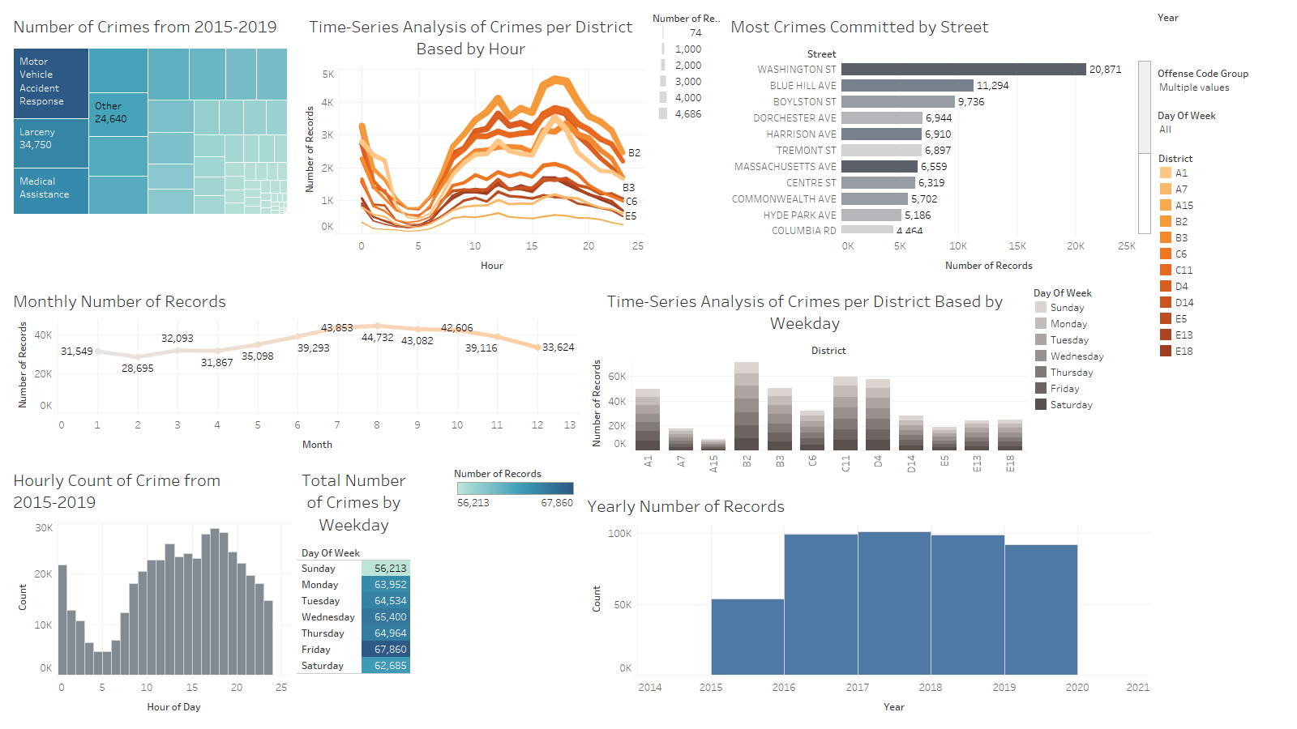
Crime dashboard
In this dashboard, the number of crimes, top street names, districts, count of records on a daily, hourly, monthly, and yearly basis shows an importance to recommend the actions for the Boston Police Department to patrol those areas and conduct investigations.
Have emergency medical services personnel to be ready to treat and get the victims to the hospital.

